Slide 1

Cryptography
CS-486
October 11th, 2017 r00 Paul A. Lambert

Slide 2
Cryptography Monday October 11th, 2017
Elliptic Curve
Projects
Passwords Again
Security Protocols
https://www.youtube.com/watch?v=-G_8ADhrzgw
ppt presentation (from Vitaly Shmatikov)
Reading: Lowe. "Breaking and Fixing the Needham-Schroeder Public-Key Protocol using FDR" (TACAS 1996).
Reading: Wang et al. "How to Shop for Free Online: Security Analysis of Cashier-as-a-Service Based Web Stores" (S&P 2011).
Reading: Chen et al. "Side-Channel Leaks in Web Applications: a Reality Today, a Challenge Tomorrow" (S&P 2010).

Slide 3
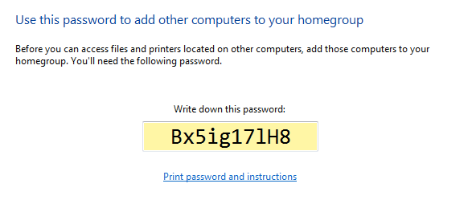
Passwords Again

Slide 4
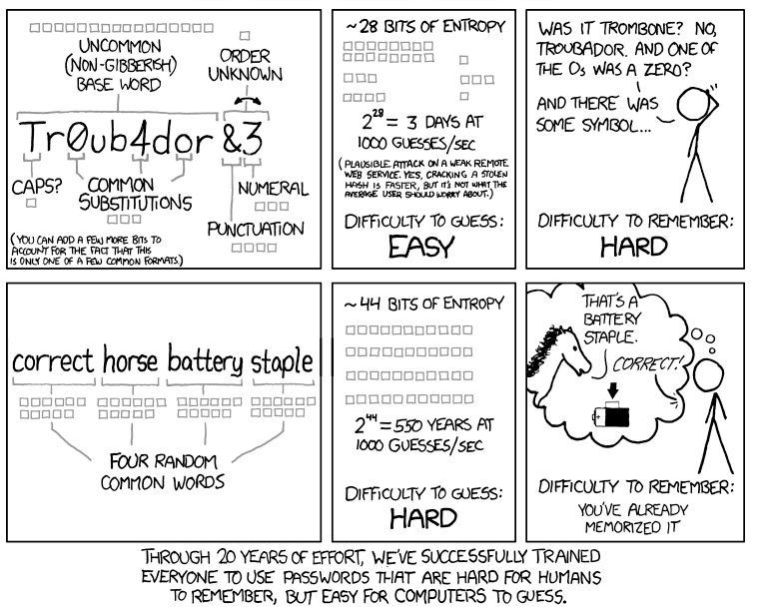
http://cups.cs.cmu.edu/soups/2012/proceedings/a7_Shay.pdf

Slide 5
Backup Material

Slide 6
Projects

Slide 7
RSA
Team: Wei Fan, Pengtao Wen
Project: Implement the RSA algorithm
Plan:
Oct. 11 - Design and requirements (PKCS#1 ?)
Oct. 25 – Code review / demo
Reading:
Gardner_RSA.pdf
http://cups.cs.cmu.edu/soups/2012/proceedings/a7_Shay.pdf
https://tools.ietf.org/html/rfc3447
http://www.moserware.com/2009/06/first-few-milliseconds-of-https.html

Slide 8
Identification
Problem Area:
SSNs are the standard method of identifying people, but what the Equifax data breach and the millions of cases of identity fraud that occur per year has shown is that this ID system is antiquated.
Proposal:
A new form of secure national identification

Slide 9
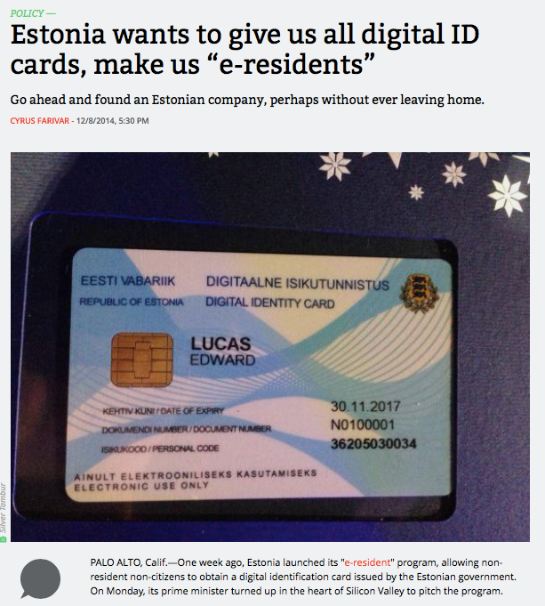
2014
description in IACR
https://www.ria.ee/public/RIA/Cryptographic_Algorithms_Lifecycle_Report_2016_2.0_A-101-3.pdf
Aris Technica 12/8/2014

Slide 10
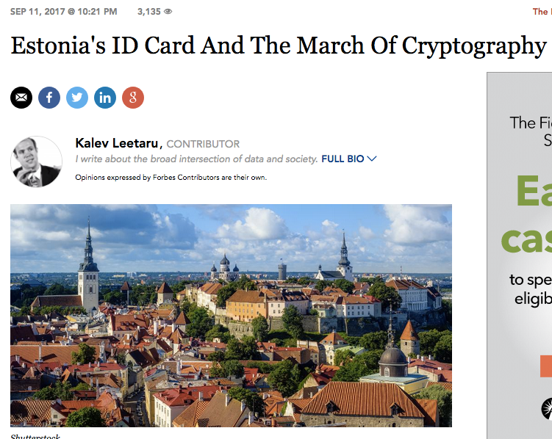
2017
Reported flaws:
http://news.err.ee/108556/the-flaw-in-the-estonian-id-card
Aris Technica 12/8/2014

Slide 11
Cracking Linux Passwords
Specification for sha256 and sha512 ‘crypt’ function:
https://www.akkadia.org/drepper/SHA-crypt.txt
A very ugly ad hoc construction based on prior usage of DES
Defaults to 5000 rounds
https://www.akkadia.org/drepper/SHA-crypt.txt
https://tools.ietf.org/html/rfc6238.html

Slide 12
Cracking Passwords
Write a Python program to crack passwords.
Requirements:
The program should operate on one or more lines from a Debian Linux ‘shadow’ password file.
For validation of operation of your program, a single line of a shadow file will be provided with a three character password to crack.
Documentation:
Test the program and determine how many passwords are tried per second.
For an 8-character password with lower case, upper case, numbers and 5 special characters – how long would it take your program to determine the password by brute force guessing of each possible password?
Hints:
The Python ‘crypt’ package is directly available and works correctly on Linux platforms. The ‘crypt’ package is available on a Mac, but does not give the correct answer. Other third-party libraries are available that you may try to use, but Linux will be easier.
Read the first chapter of: Violent Python A Cookbook for Hackers, Forensic Analysts, Penetration Testers and Security Engineers (Links to an external site.)Links to an external site.
Pay special attention to pages 20 to 24.

Slide 13
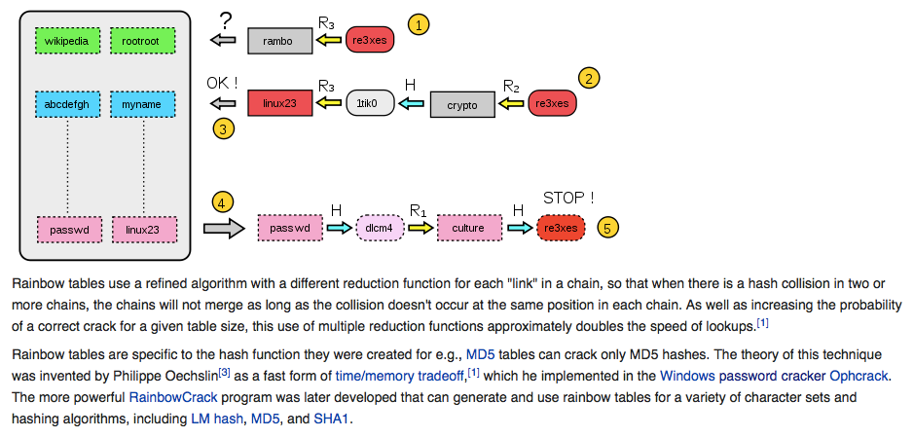
Rainbow Tables
A means to break longer passphrases
Trades time for storage

Slide 14
More Password References
Robert Morris and Ken Thompson, “Password Security: A Case History”, 1979, url
Cracking Active Directory Passwords
http://www.cs.cornell.edu/~shmat/courses/cs6431/passwords.pdf
https://eikonal.wordpress.com/category/it/infosec/security-hardening/
https://www.akkadia.org/drepper/SHA-crypt.txt
Dictionaries:
https://wiki.skullsecurity.org/Passwords
https://www.giac.org/paper/gsec/42/password-cracking-focused-dictionaries/100346
http://www.wirelesshack.org/wpa-wpa2-word-list-dictionaries.html
http://web.cs.du.edu/~mitchell/forensics/information/pass_crack.html
https://spqr.eecs.umich.edu/courses/cs660sp11/papers/10.1.1.128.1635.pdf
http://www.cs.cornell.edu/~shmat/courses/cs6431/passwords.pdf

Slide 15
Authentication and Tokens
What is possible beyond the use of passwords?
http://www.cs.cornell.edu/~shmat/courses/cs6431/authtokens.pd
https://tools.ietf.org/html/rfc6238.html

Slide 16
Bitcoin
Reading Assignment
Satoshi Nakamoto, "Bitcoin: A Peer-to-Peer Electronic Cash System” Read up to section 3
Bitcoin and Cryptocurrency Tecnologies (book)
Read up to section 1.3
Mastering Bitcoin (on CS486 github)
Read pages 70 to 75

Slide 17
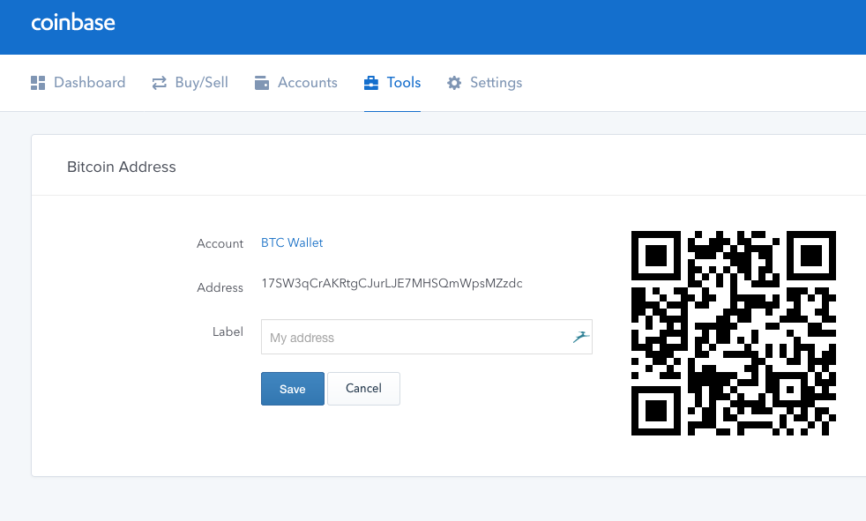

Slide 18
Bitcoin Addresses
Bitcoin uses 256-bit elliptic curve public/private key pairs. An elliptic curve private key is a large random integer.
private_key = str_to_int(os.urandom(32))
The corresponding public key is the ‘point’ formed by multiplying the private key times a ‘generator’ G for the SECP_256k1 curve.
curve = SECP_256k1()
G = curve.generator
public_key = private_key*G # an ECC point
The address is a readable hash of the public key.

Slide 19
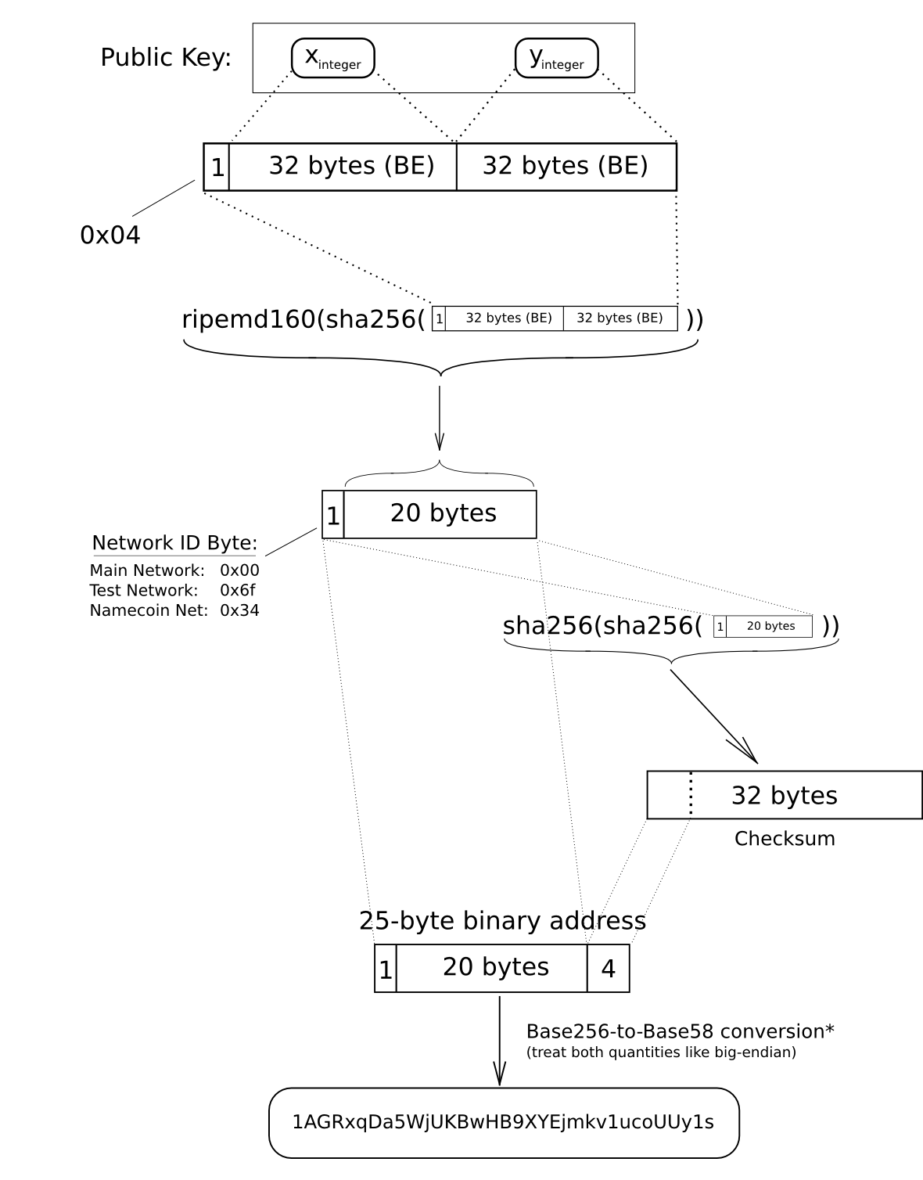
Elliptic-Curve Public Key to BTC Address Conversion
A 256-bit (64 char) public key is hashed and converted to a base58 string.
Sources:
https://en.bitcoin.it/wiki/Technical_background_of_version_1_Bitcoin_addresses
http://en.bitcoinwiki.org/File:BitcoinAddress.png

Slide 20
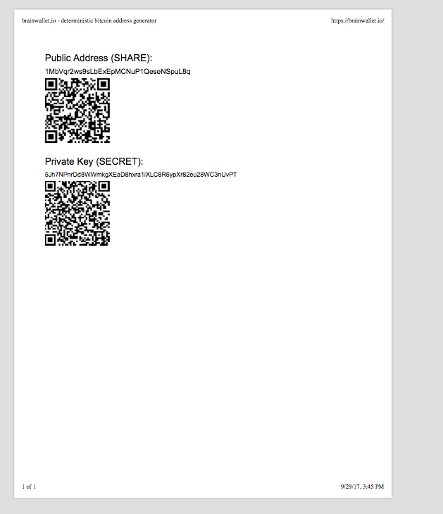
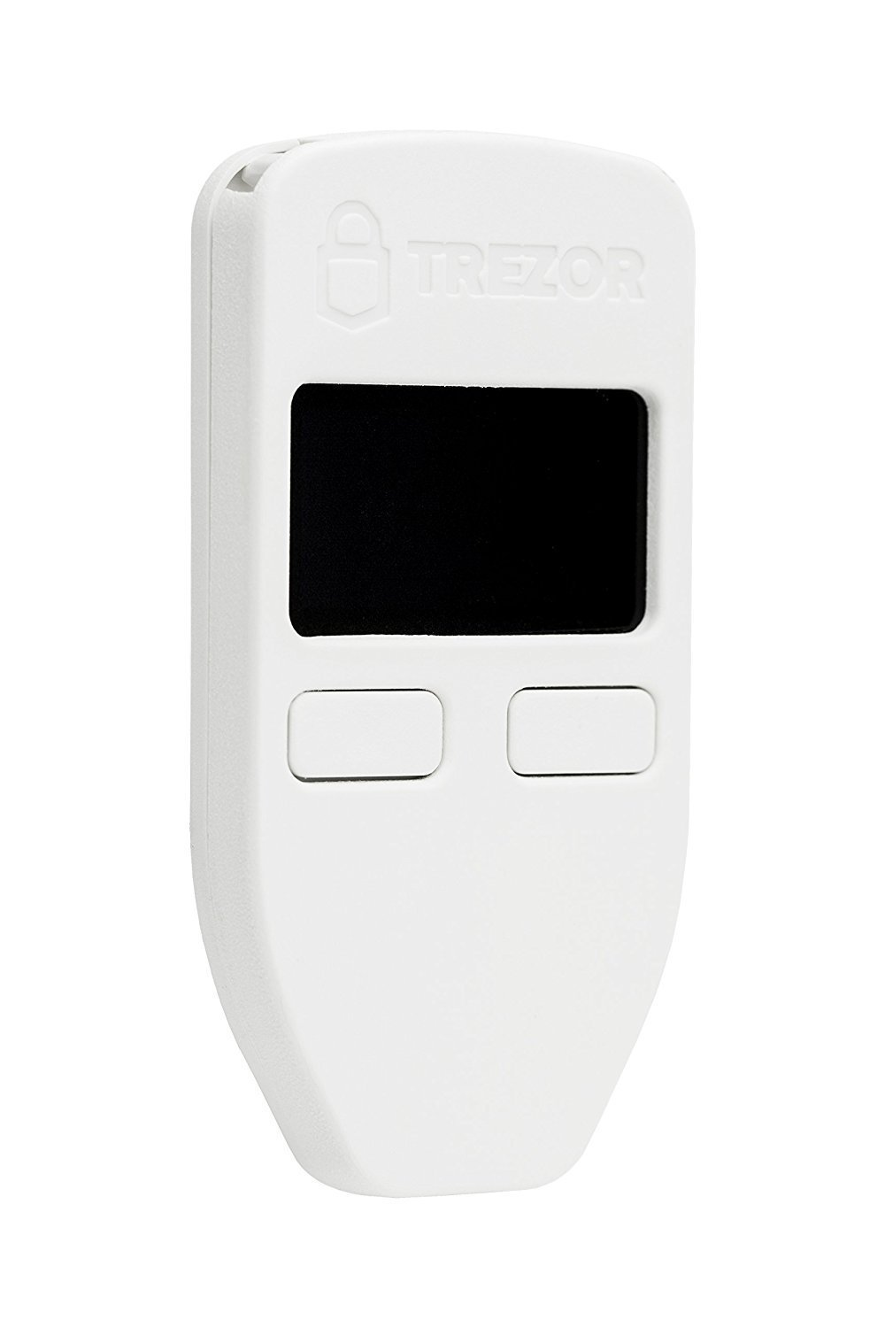
Wallet Types
Wallet types:
Desktop http://electrum.org
Mobile
Online https://www.coinbase.com
Hardware
Paper
Brain https://brainwallet.io/

Slide 21
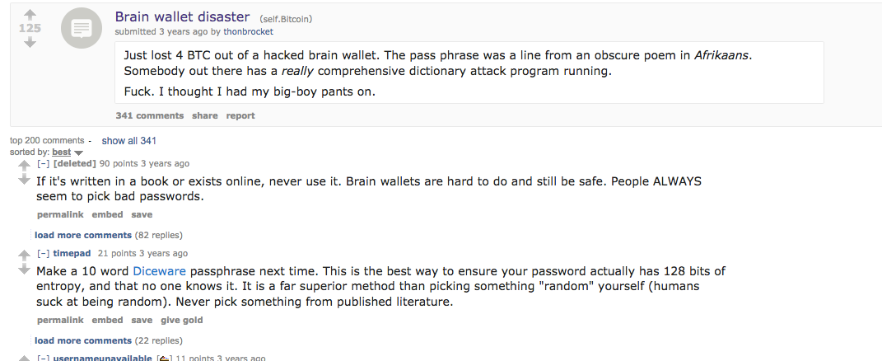
Cracking Brain Wallets
https://www.reddit.com/r/Bitcoin/comments/1ptuf3/brain_wallet_disaster/
https://arstechnica.com/information-technology/2016/02/password-cracking-attacks-on-bitcoin-wallets-net-103000/
https://arstechnica.com/information-technology/2013/10/how-the-bible-and-youtube-are-fueling-the-next-frontier-of-password-cracking/
https://en.wikipedia.org/wiki/Rainbow_table

Slide 22
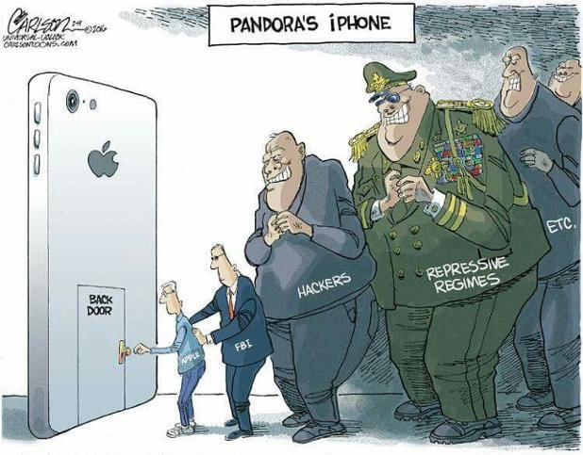

Slide 23
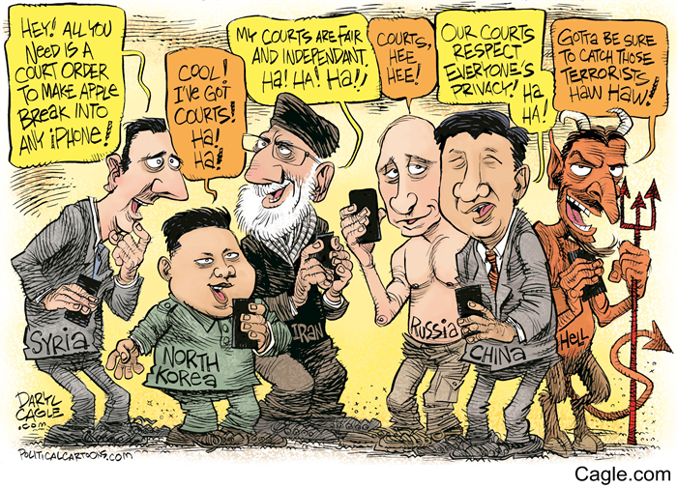

Slide 24
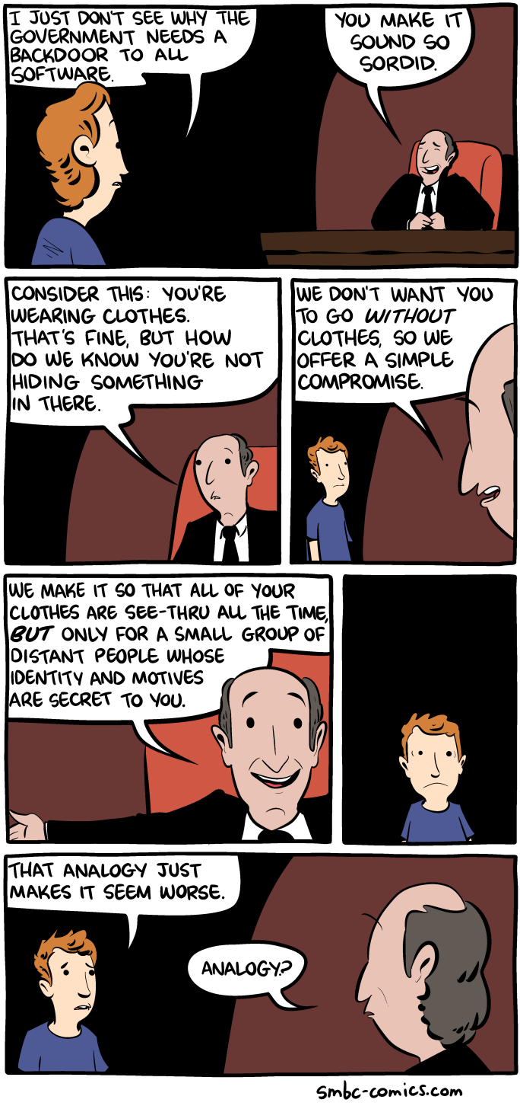

Slide 25
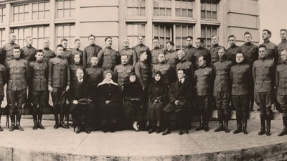

Slide 26
Python References
Python Documentation (Python Web Site)
Code Like a Pythonista: Idiomatic Python (Web site)
Transforming Code into Beautiful, Idiomatic Python (video)
Functional programming in Python
Writing Awesome Command-Line Programs in Python
Building Command Line Applications with Click
PyCon 2010 presentation, Easy Command-Line Applications with cmd and cmd2: slides, video
Look at repositories for Python crypto implementations and read the code.

Slide 27
Encryption Attacks
CPA - Chosen Plaintext Attack
An attacker can obtain the ciphertext for any provided plaintext (but does not have the key).
CCA - Chosen Ciphertext Attack
An attacker can also, in addition to being able to perform a CPA, obtain the plaintext for any provided ciphertext (but does not have the key).

Slide 28
Indistinguishability and Non-Malleability
IND - Indistinguishability
The advantage of a reasonable adversary determining what message was sent,
IND-CPA - Indistinguishability under a Chosen Plaintext Attack
IND-CCA - Indistinguishability under a Chosen Ciphertext Attack
INT - Integrity
INT-PTXT - Computationally infeasible to produce a ciphertext decrypting to a message which the sender has never encrypted
INT- CTXT – Computationally infeasible to produce a ciphertext not previously produced by the sender, regardless of whether or not the underlying plaintext is “new”
NM - Non-malleability
Is the advantage of a reasonable adversary being able to change the message to be meaningful
NM-CPA - Non-malleability under a Chosen Plaintext Attack
NM-CCA - Non-malleability under a Chosen Ciphertext Attack
WUF - Weakly unforgeable MAC
An attacker (with the capability of making chosen message attacks) is incapable of creating a new accepted message and tag pair (the message cannot have previously been queried).
SUF - Strongly unforgeable MAC
An attacker (with the capability of making chosen message attacks) is incapable of creating a new accepted message and tag pair (the tag cannot have previously been returned in response to a query - but the message may have been queried).
https://www.cs.jhu.edu/~astubble/dss/notes3c.pdf
http://cseweb.ucsd.edu/~mihir/papers/oem.pdf

Slide 29
Logistics for Class
Canvas CS-486-01
Primary repository for grading
URL for all homework submittals must be ‘linked’ into the appropriate Canvas assignment!
Github: https://github.com/CryptoUSF
Course material, class presentations, references, books
Sample code for assignments: https://github.com/CryptoUSF
Private student repositories,
too many if one per assignment per student
Wiki for additional class information and assignements
Piazza: CS486
Informal class conversations

Slide 30
Additional References
Courses:
https://crypto.stanford.edu/~dabo/courses/OnlineCrypto/
http://cseweb.ucsd.edu/~mihir/cse207/
Conferences:
Real World Cryptography
https://www.iacr.org
Mailing Lists and Standards:
http://csrc.nist.gov US Federal security specifications
https://trac.ietf.org/trac/sec/wiki Internet security standards
https://irtf.org/cfrg Internet cryptographic research

Slide 31
File Encryption with Classic Ciphers
HW1
Write a Python command-line program to encrypt or decrypt a file.
The program should: - provide command to encrypt or decrypt a file - provide option flags to select the algorithm to use for encryption or decryption - multiple simple ciphers should be implemented and should include: - the Caesar Cipher - another simple substitution cipher - a poly-alphabetic cipher - a transposition cipher For every algorithm you implement, please include a description of the algorithm in the docstring and a reference to the source description of the algorithm. References should be wherever possible to historic text for these older algorithms. A list of books are in Canvas for such references.
Example solution code for assignment: https://github.com/CryptoUSF/CS486/blob/master/code/cipher.py
Existing python library reference: pycipher

Slide 32
Cryptanalytic Toolkit
HW2
Write a cryptanalytic toolkit in Python to analyze the statistical properties of files.
Determine the frequency distribution of characters in an arbitrary string. Print out the Monogram distribution of the characters.
Determine the Bigram, Trigram or higher distribution of symbols in a file.
Example solution code for assignment: https://github.com/CryptoUSF/CS486/blob/master/code/cipher.py

Slide 33
Prime Numbers
HW3
Review section 4.2 of the “Handbook of Applied Cryptography” [HAC]. Closely read section 4.2.3 (Rabin-Miller)
Complete the ‘is_prime’ routine in: https://github.com/CryptoUSF/CS486/blob/master/code/prime.py
Your goal is to understand the nature of generating ‘good’ prime numbers. You should understand the implications of the selection of the number of iterations of the Rabin-Miller algorithm. This is a useful routine that you should write to a ‘production grade’. Look at other references and worked code example for the best way to select the number and value of the witness numbers.

Slide 34
Block Ciphers and Hashing
HW4
Write a Python command-line program to:
Encrypt or decrypt a file using a contemporary block cipher
Pick a ‘good’ mode of operation
Consider how to protect the key used for the encryption
Write a Python command-line program to:
Hash a file using at least two contemporary hash algorithms

Slide 35
Cracking Passwords
HW5
Write a Python command-line program to:
Encrypt or decrypt a file using a contemporary block cipher
Pick a ‘good’ mode of operation
Consider how to protect the key used for the encryption
Write a Python command-line program to:
Hash a file using at least two contemporary hash algorithms

Slide 36
Raspberry Pi
We will use a Raspberry Pi to get experience using contemporary analysis ‘tools’
Raspberry Pi
Excellent reference for what to acquire and how to setup:http://rpi.cs.usfca.edu/2017-fall
The first Pi project will use cryptographic related tools that are available in the Kali distribution: https://www.kali.org/
The tools do not necessarily require the Kali OS distribution and you may be able to simply install some of the tools on an existing Raspberry Pi OS installation.

